Slide 1

Flight Price Prediction
DATA 606
Capstone in Data Science
Project by: Lohith Reddy Meruva(KT97617)
KT97617@umbc.edu
Supervised by: Chaojie (Jay) Wang, D.Sc.

Slide 2

Problem Statement
Anyone who has ever booked a flight is familiar with unpredictable price fluctuations. The price of the most affordable ticket for a particular flight may fluctuate, increase or decrease as a strategy to optimize revenue. Such changes often occur as airlines seek to maximize profits.
Employing purchasing timing strategies to ensure that last-minute acquisitions come at a premium cost.
Managing seat occupancy by increasing prices on flights nearing full capacity,
So, you have to work on a project where you collect data on flight fares with other features and work to make a model to predict the fares of flights.

Slide 3


Slide 4
Flight Price Prediction
Travelers aim to secure the most economical ticket prices, whereas airlines strive to maintain peak revenue and optimize profits.
In 2020, India stood as the third-largest aviation market, projected to become the largest by 2030.
For passengers, the crucial challenge lies in identifying the optimal price and timing for ticket purchases.
The traditional notion that "pre-purchased tickets are more affordable" is no longer applicable (William Groves and Maria Gini, 2013).

Slide 5
Flight Price Prediction
Yatra.com asserts that forecasting the specific ticket price poses a greater challenge than determining the optimal time for ticket purchase, attributed to various factors.
A heightened level of competition corresponds to diminished market influence for airlines, thereby reducing the likelihood of fare hikes.
Skyscanner in their evaluation, highlights the Bagging Regression Tree as the most effective model, displaying resilience unaffected by variations in input feature sets.
The introduction of Low-Cost Carriers (LCC) in a market significantly influences both the overall passenger volume and air ticket prices.

Slide 6
Flight Price Prediction
Airlines commonly transfer the expense of aviation fuel to passengers by modifying fares to offset changes in crude oil prices.
Additionally, it has been observed that ticket prices begin to rise again when the flight is within a 2-3 day window.
Short-haul flights demonstrate greater elasticity, indicating heightened price sensitivity, compared to their long-haul counterparts.
In contrast, business class flights exhibit lower elasticity compared to leisure class flights, as business travelers typically have less flexibility in altering or canceling their travel dates.

Slide 7
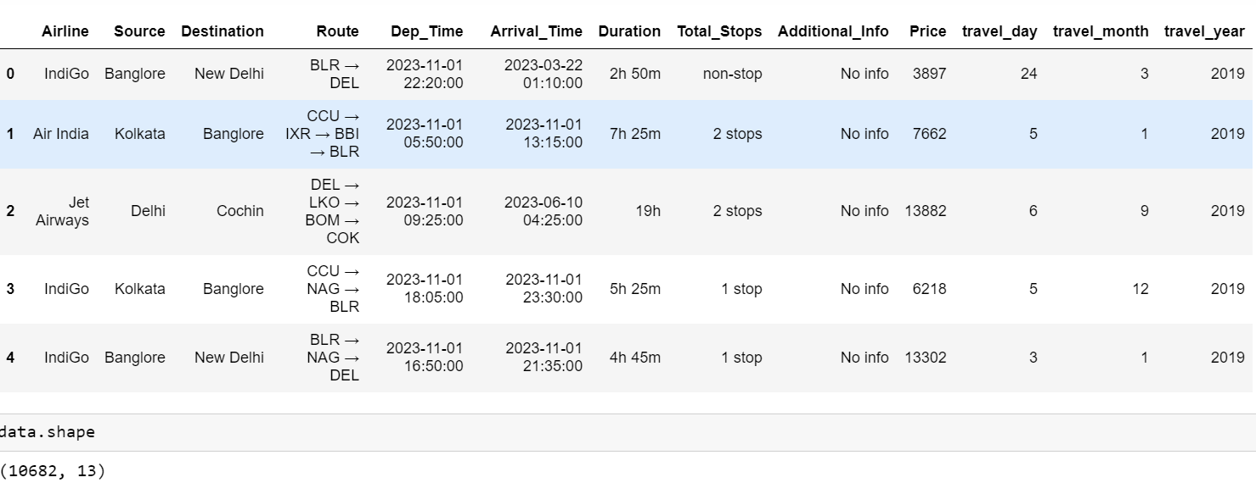
Dataset Information
Here the data is collected from
Yatra .com
Datasource: https://www.kaggle.com/datasets/jillanisofttech/flight-price-prediction-dataset
The dataset contains flight details of around 10682 Flights on different routes
The dataset has 11 features like Airlines, Duration, Route, Price, etc.

Slide 8
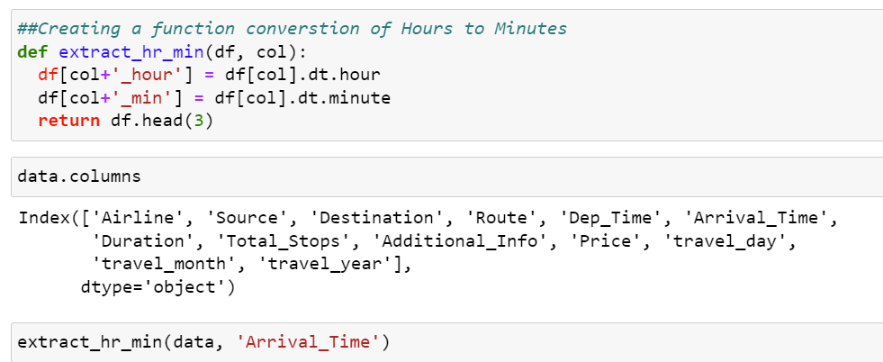
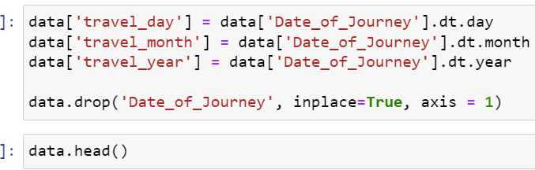
Data Preprocessing
Conversion of Duration column from hr & Minutes format into Minutes.
Conversion of Date of Journey to Date Month& year

Slide 9
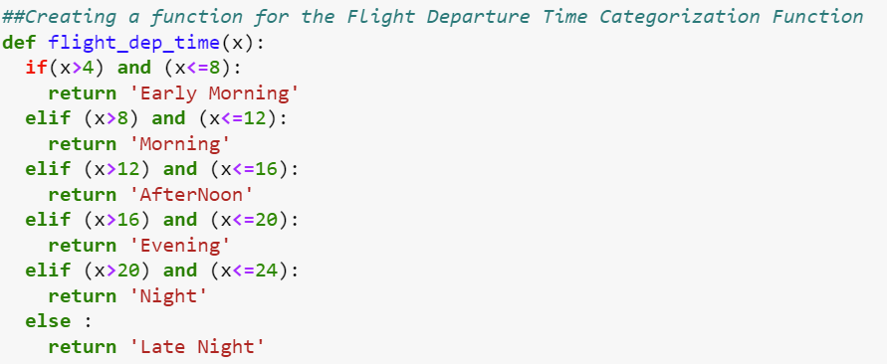
Data Preprocessing
Creating a function for the Flight Departure Time Categorization Function

Slide 10


Slide 11
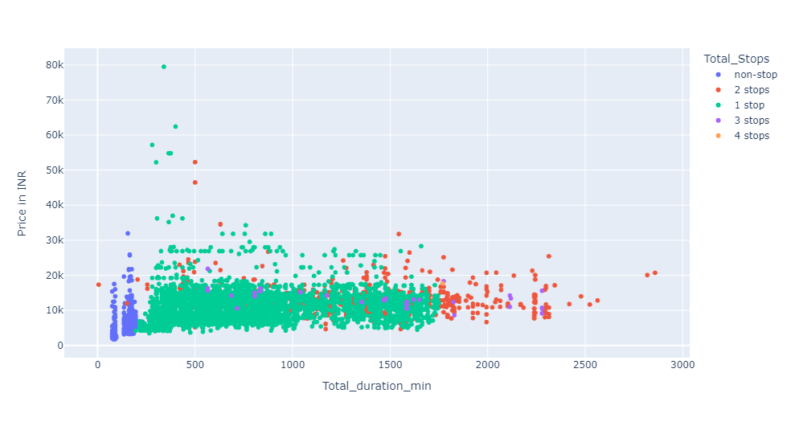
Price variation analysis
Relationship Between Duration and Price:
Flight prices tend to rise as the total flight duration increases, especially for longer and multi-stop flights.
Non-stop flights are generally more cost-effective and cluster at lower prices, while flights with multiple stops can vary widely in price and often cost more.
Notes:
There is a wide range of flight prices across different flight durations. Generally, as the total duration of the flight increases, there is a tendency for the price to increase, particularly for flights with longer durations and more stops.

Slide 12
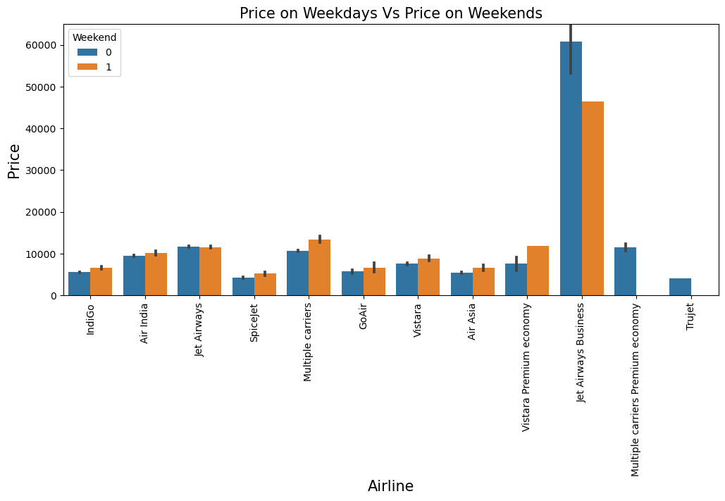
FARE ON WEEKDAY VS WEEKENDS
Weekend Price Surge: The chart shows that flight prices are generally higher on weekends than on weekdays for most airlines.
Notable Exception: Vistara airline bucks the trend slightly, with its weekday prices appearing marginally higher than the weekend prices.
Jet Airways Business Class: The most significant difference between weekday and weekend prices is seen with Jet Airways Business class, where weekend prices are much higher.

Slide 13
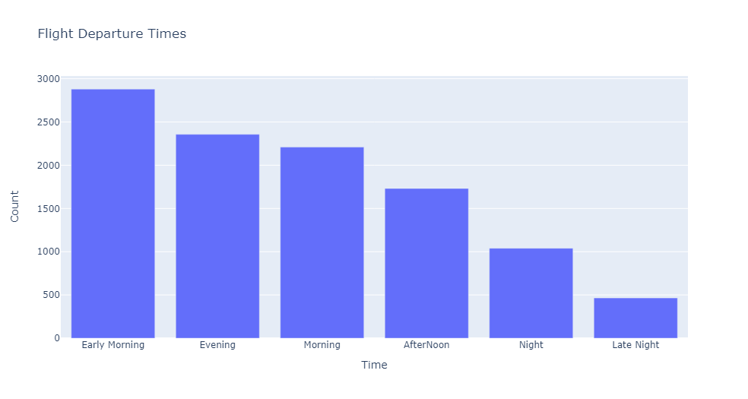
DEPARTURE TIMES
Most Popular Departure Time: Early morning flights have the highest count of departures, indicating a preference or greater availability of flights during this time.
Least Popular Departure Time: Late-night flights are the least common, which could suggest lower demand or fewer flight offerings during these hours.
Daytime Flight Distribution: Evening and morning times have a similar, moderate number of flight departures, while afternoon and night times see a decrease in flight departures.

Slide 14
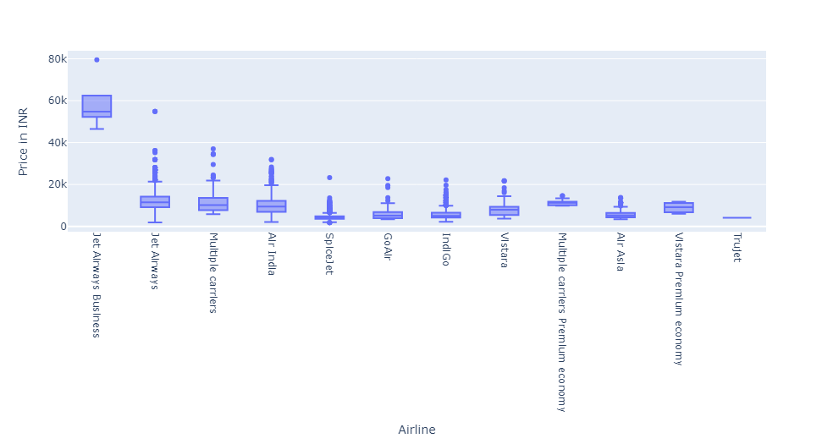
PRICE VS AIRLINE
Air India and SpiceJet show lower median prices with tighter distributions.
Go Air and IndiGo are the most economical with very low median prices.
Vistara and Multiple carriers offer mid-range prices.
Premium Economy options for multiple carriers and Vistara show higher prices than their economy counterparts.
TruJet displays a single price point, suggesting less variability.
The data clearly shows that Jet Airways Business Class has the highest prices. However, apart from the top Airline, the others have almost comparable median prices.

Slide 15
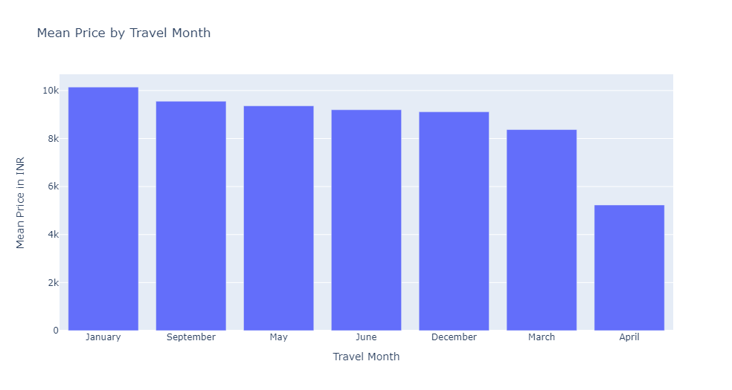
Travel Cost Analysis by Month
January: Highest cost at ~10k INR.
September, May, June: Costs between 8k-9k INR.
December, March: Lower costs at ~7k-8k INR.
April: Lowest cost at ~4k INR.
Trend: Prices peak in January; April is most economical.
Strategy: Opt for off-peak travel for savings; adjust pricing for demand.january

Slide 16
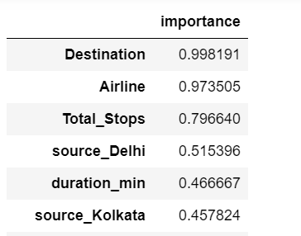
Feature Importance for Flight Price Prediction
The prediction of flight prices is most significantly influenced by the destination and airline, with importance scores of 0.998 and 0.974, respectively. Source cities, duration, and timing of the flight also impact prices to a lesser degree, while the travel date and year offer minimal to negligible predictability.

Slide 17
MODEL PREDICTION

Slide 18
Machine Learning Model Building
This problem can be solved using regression-based machine learning algorithm.
Methodology to Build Machine Learning Model:
Encoding Categorical data into Numerical data
Scaling data using Standard Scalar
Splitting data in training & test data using train_test_split from model_selection
Implementing various Regression Based Algorithm to build ML Model
Conducting 5 fold Cross-validation
Hyper Parameter tuning of Best Model
Saving Final Tuned Model using pickle

Slide 19
REGRESSION ALGORITHMS IMPLEMENTATION
The different regression algorithms used in this project to build the ML model are as below:
Linear Regression
Lasso Regression
Ridge Regression
Random Forest Regressor
Decision Tree Regressor
Gradient Tree Regressor

Slide 20
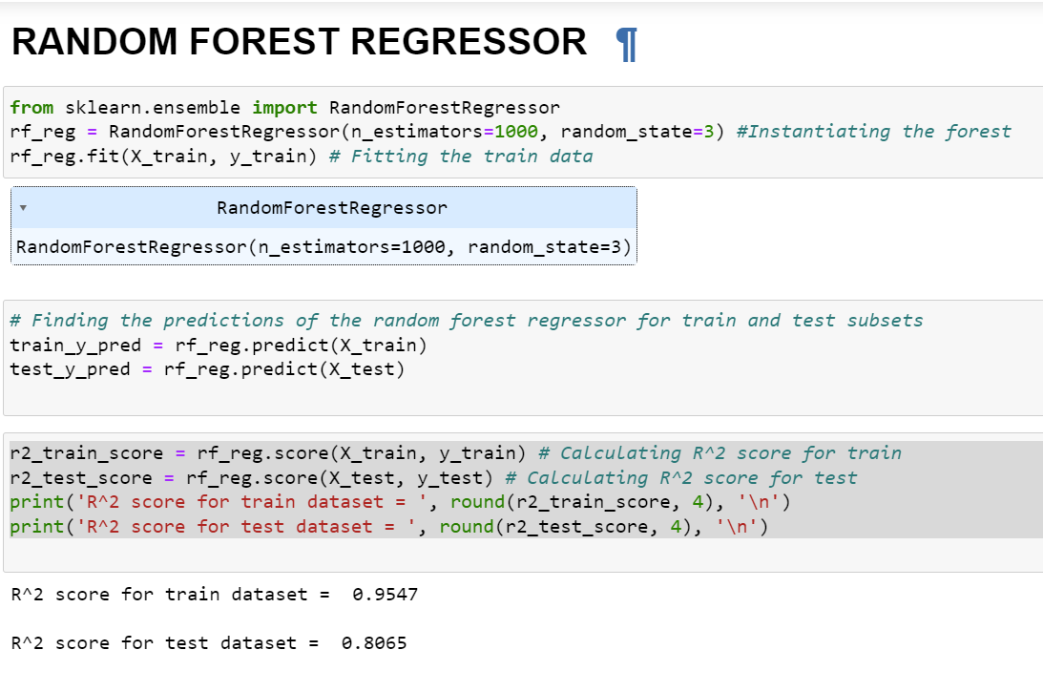
Hyper Parameter Tuning of Best Model
Random Forest Regressor gives a maximum R2 score of 95.45 and a maximum cross-validation score.

Slide 21
FINAL EVALUATION MATRIX
MODEL | Train R^2 Score | Test R^2 Score
Linear Regression | 0.5776 | 0.5624
Lasso Regression | 0.5776 | 0.5624
Ridge Regression | 0.5776 | 0.5624
Random Forest Regressor | 0.9546 | 0.8071
Decision Tree Regressor | 0.7082 | 0.6996
Gradient Boosting Regressor | 0.8896 | 0.8278

Slide 22
Limitations & Future Scope
In this study we focus on flights on one year of data and more data can be incorporated in this project to extend it beyond the present investigation.
This project aimed to develop a machine learning model that could accurately predict the fare of the ticket of features available in the dataset.
The web application assists the passengers in ticket bookings.
There is potential for improving the model's accuracy by incorporating additional features, expanding to more locations, and gathering more data, among other possibilities.
Time series analysis can be performed over this model.
This project can result in saving money for inexperienced people by providing them the information related to trends in flight prices and also giving them a predicted value of the price which they use to decide whether to book a ticket now or later. On working with different models

Slide 23

References:
Masoud Soroush 602 Notes
V. Rao and J. Sachdev, "A machine learning approach to classify news articles based on location",
V. Kumar and S. Minz, "Poem classification using machine learning approach", Proceedings of the Second International Conference on Soft Computing for Problem Solving (SocProS 2012
B.Pang, L. Lee and S. Vaithyanathan, "Thumbs up? Sentiment classification using machine learning techniques" in Language

Slide 24
THANK YOU

